Slide 1
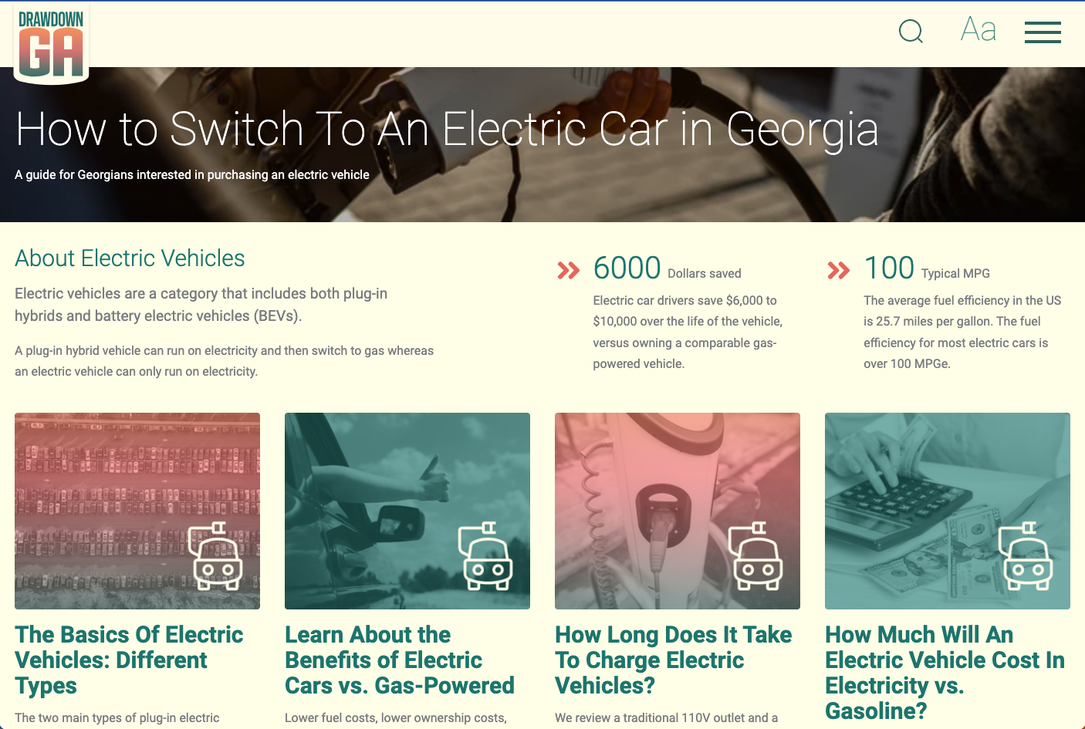

Slide 2


Who We Are: Southern Alliance for Clean Energy

Slide 3
Agenda
EV Ownership 101
Plug-in Hybrid vs Pure Electric
What's it like to drive an EV and benefits
What does owning an EV cost
How far can EVs go
What models are available
Charging an EV
How long does it take to charge?
Where do you find charging?
EV Policies and Programs

Slide 4

Why Electric Vehicles (EVs)?
The transportation sector is now the largest source of carbon dioxide (CO₂) pollution in the United States.
We can do something about that!

Slide 5
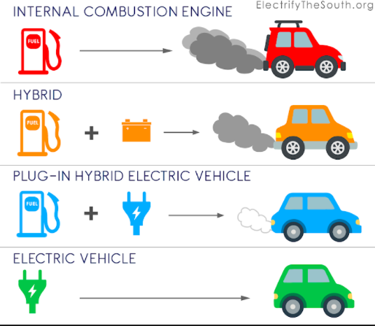
What Is An EV?

Slide 6
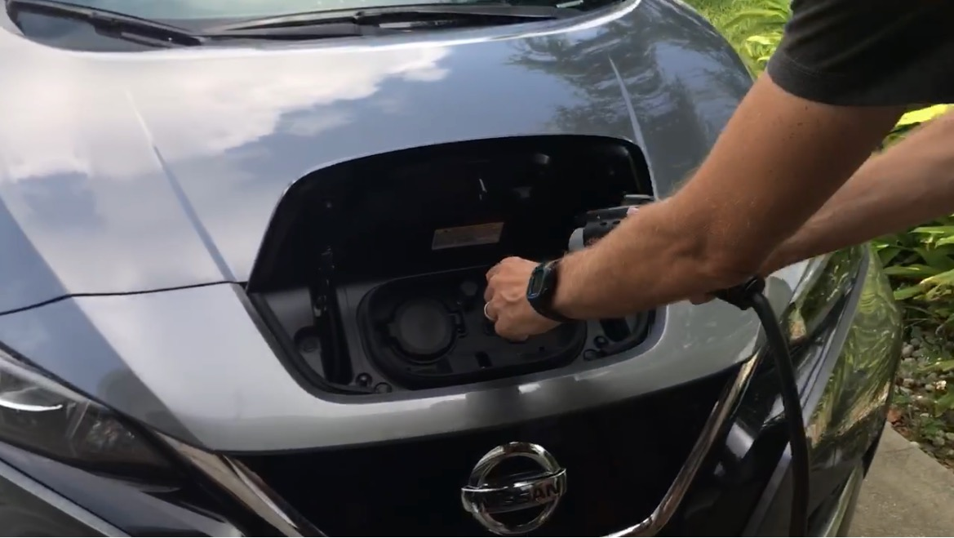
Benefits: EVs are Convenient
No trips to gas station
No oil changes
Very low maintenance
Charging at home is convenient
Smooth, quiet, instant torque

Slide 7
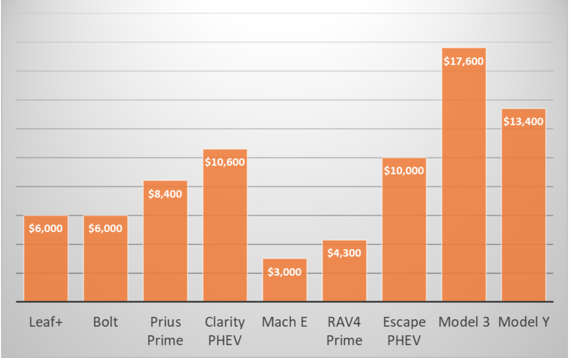
Benefit: Lower Total Cost to Operate
Lifetime Savings From EVs vs. Best-Selling Gasoline Powered Vehicles in Class
Typical driver saves $6,000 to $10,000 over the life of the vehicle,
vs.
owning a comparable gas-powered vehicle.
Source: Consumer Reports

Slide 8
Benefit: Fueling an EV Is Much Cheaper Than Gas
MODEL | COST PER MILE (CENTS) | 1,000 MILES COST (DOLLARS)
Gasoline | 13.8 | $138
Electric | 4.5 | $45
Assuming $3.60 cost per gallon of gasoline and 26 mpg
33.7kW/h= 1 gallon
Assuming $.12/kWh and 120 mpge
Driving electric may add about $40-45 per month to your utility/power bill.
Driving electric will cut your fuel costs by more than half.
Source: Gas and electricity costs Source: Fuel efficiency

Slide 9
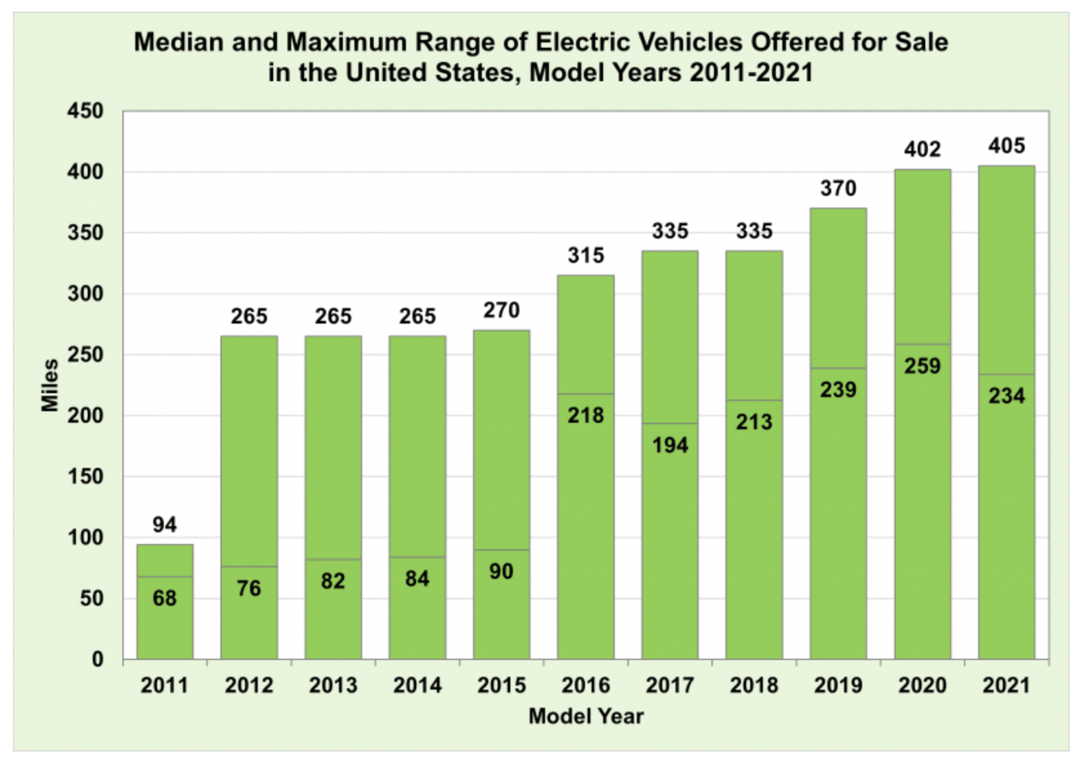
Range: How Far Can You Go In An EV
Source: EPA Fact of the Week

Slide 10
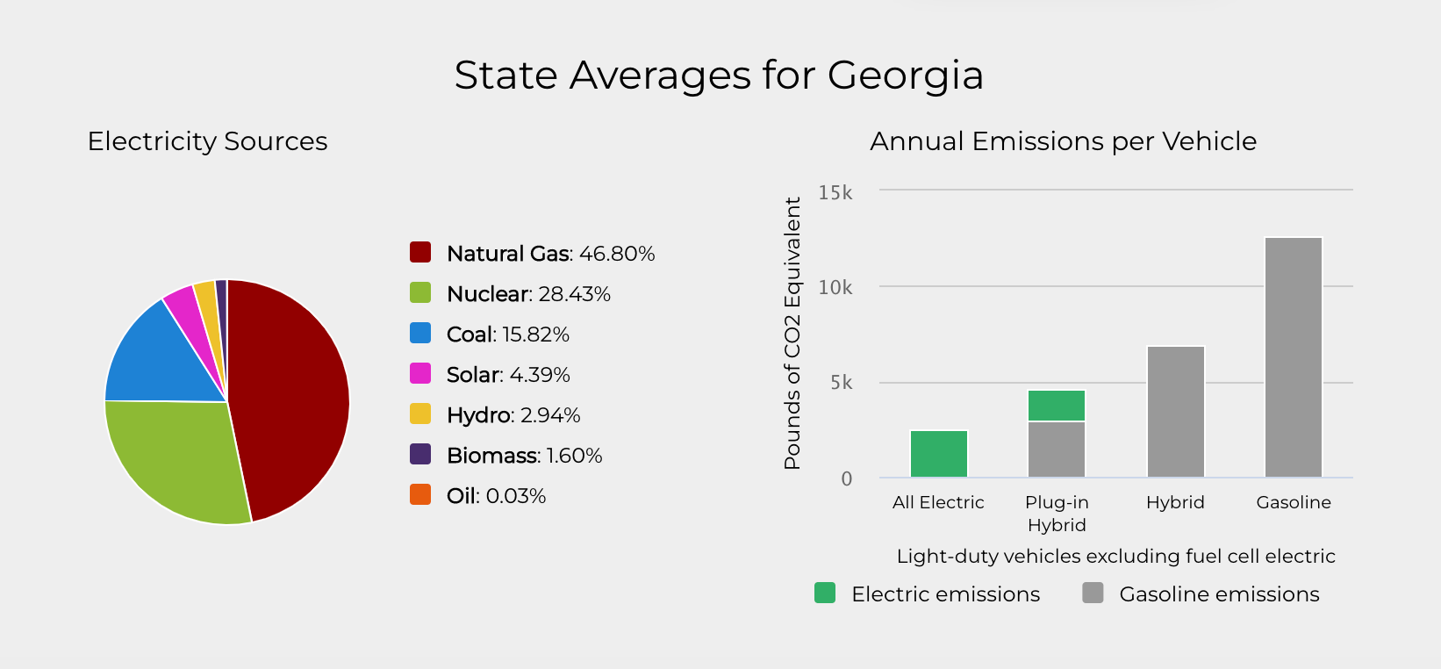
Benefit: EVs Have Fewer Emissions
In GA, the average EV produces only 2,480 lbs. of CO₂e per year, compared to 12,594 lbs. by gasoline powered vehicles.
Source: Department of Energy Alternative Fuels Data Center

Slide 11
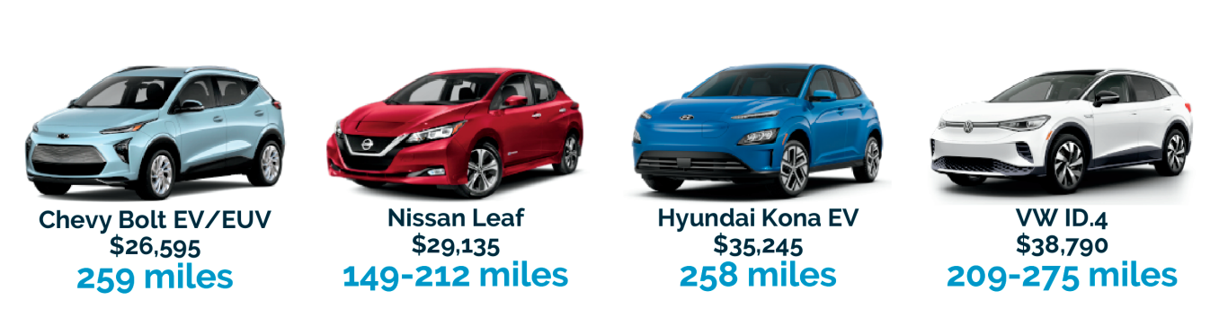
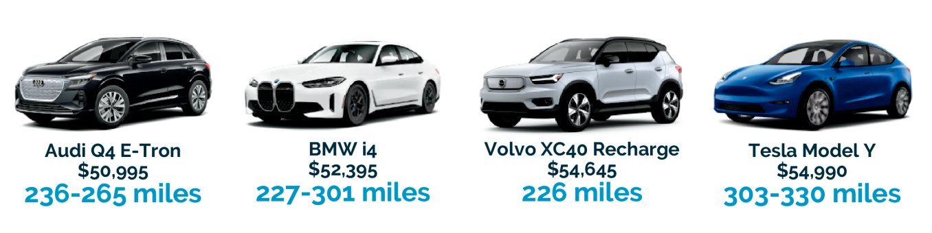


Models To Meet Your Needs
Source: Plug In America EV Guide 2023

Slide 12
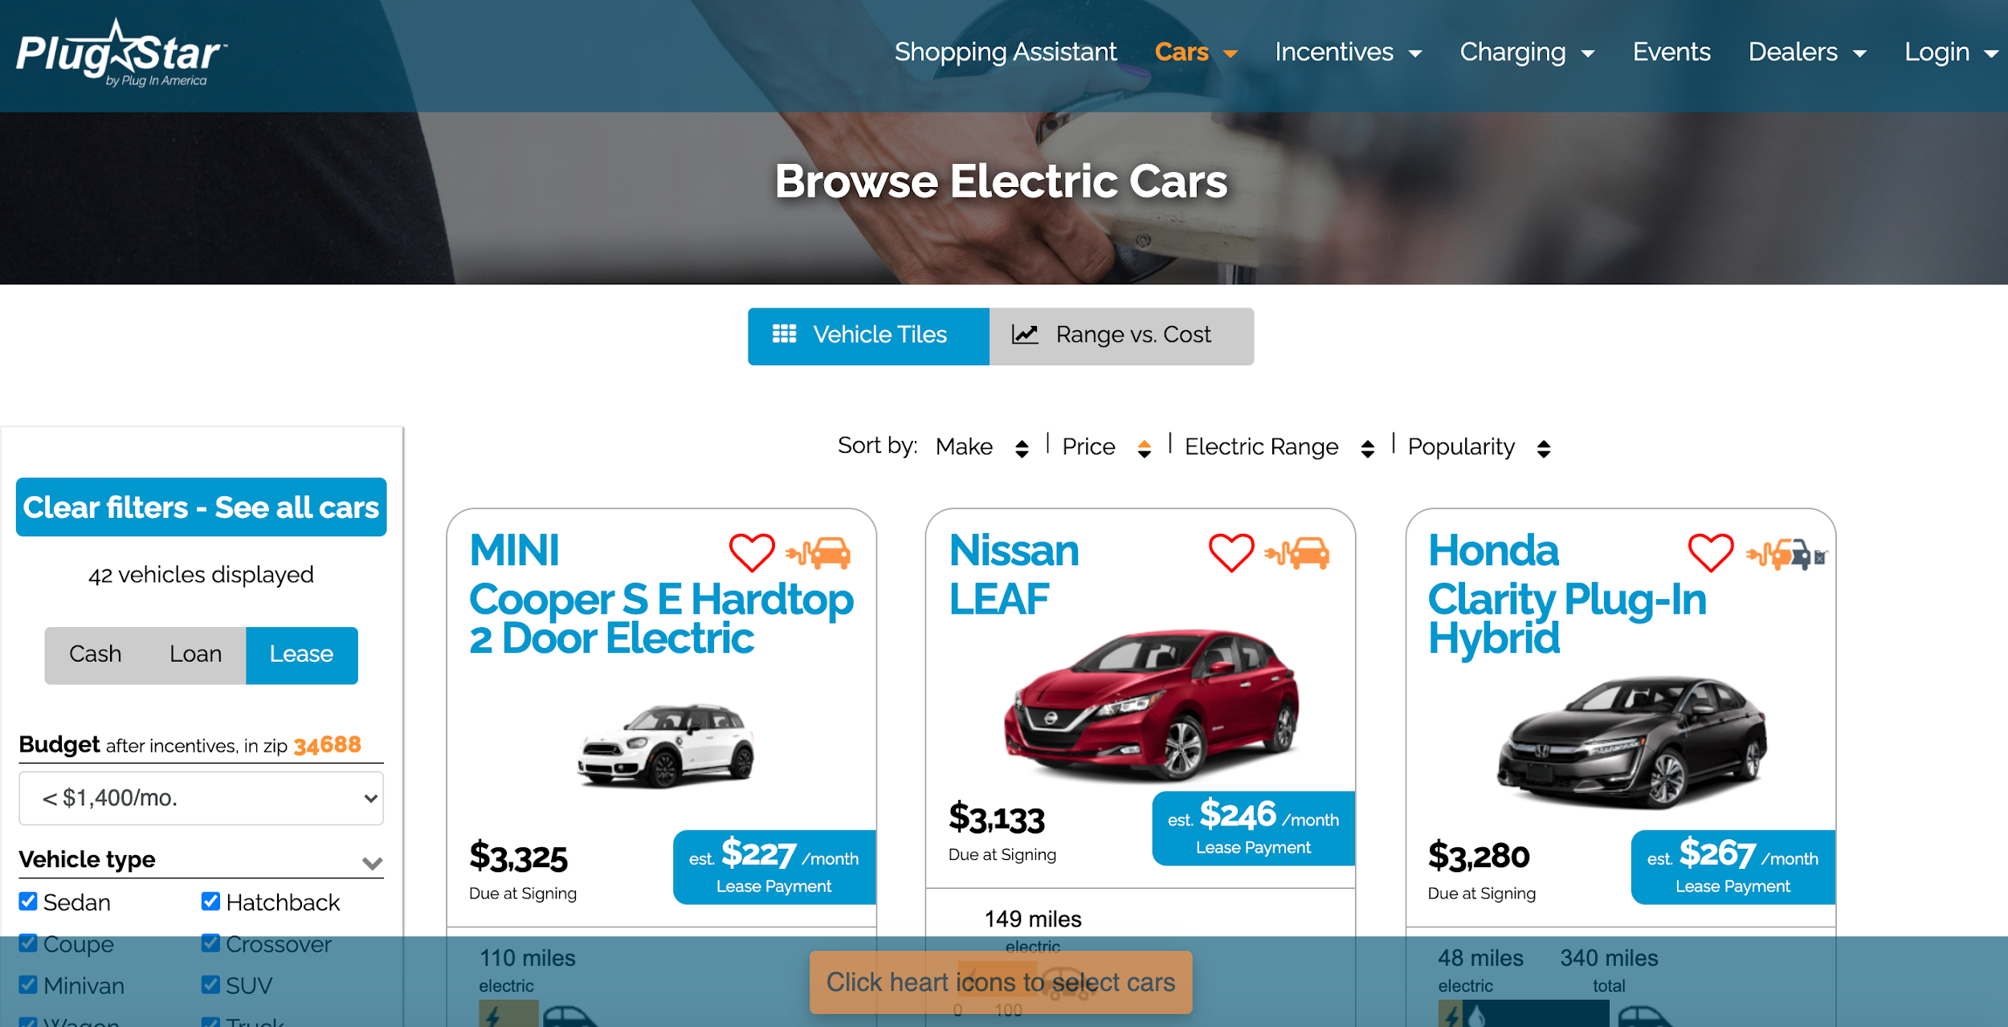
How to Browse EV models? PlugStar website
https://plugstar.com/

Slide 13
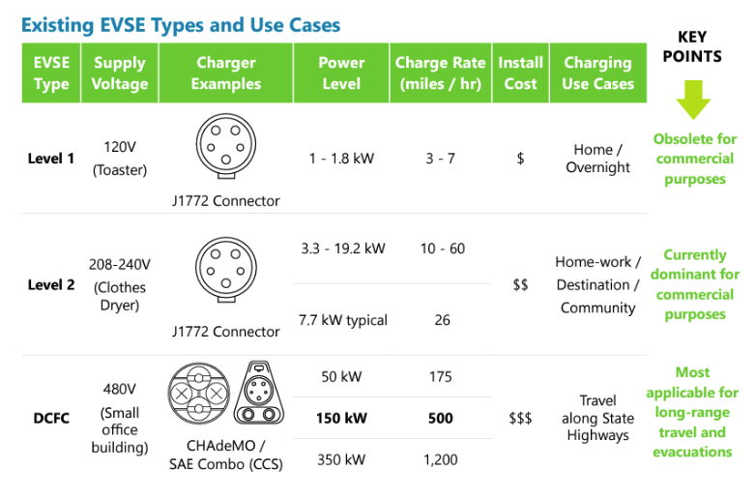
Charging Your EV

Slide 14
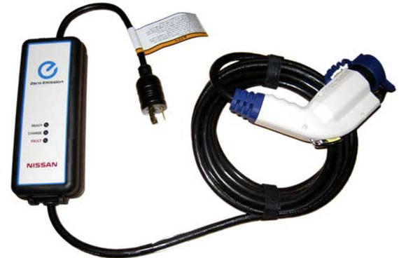

Charging your EV
Level 1 Charging 110V (~1.4kW)
3-5 miles per hour

Slide 15
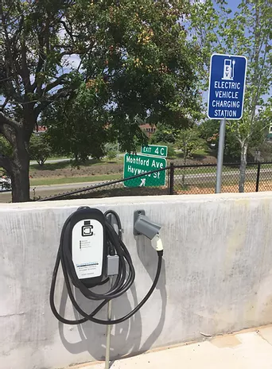
Charging your EV
Level 2 Charging 220V (7-19kW)
25-60 miles per hour

Slide 16
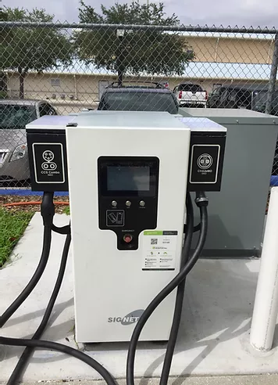

Charging your EV
DC Fast Charging (50- 350kW)
Up to 80% battery capacity per half hour

Slide 17
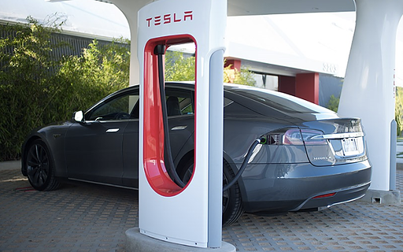
Charging Your EV
Tesla Charging
Level 1
Level 2
Supercharging

Slide 18
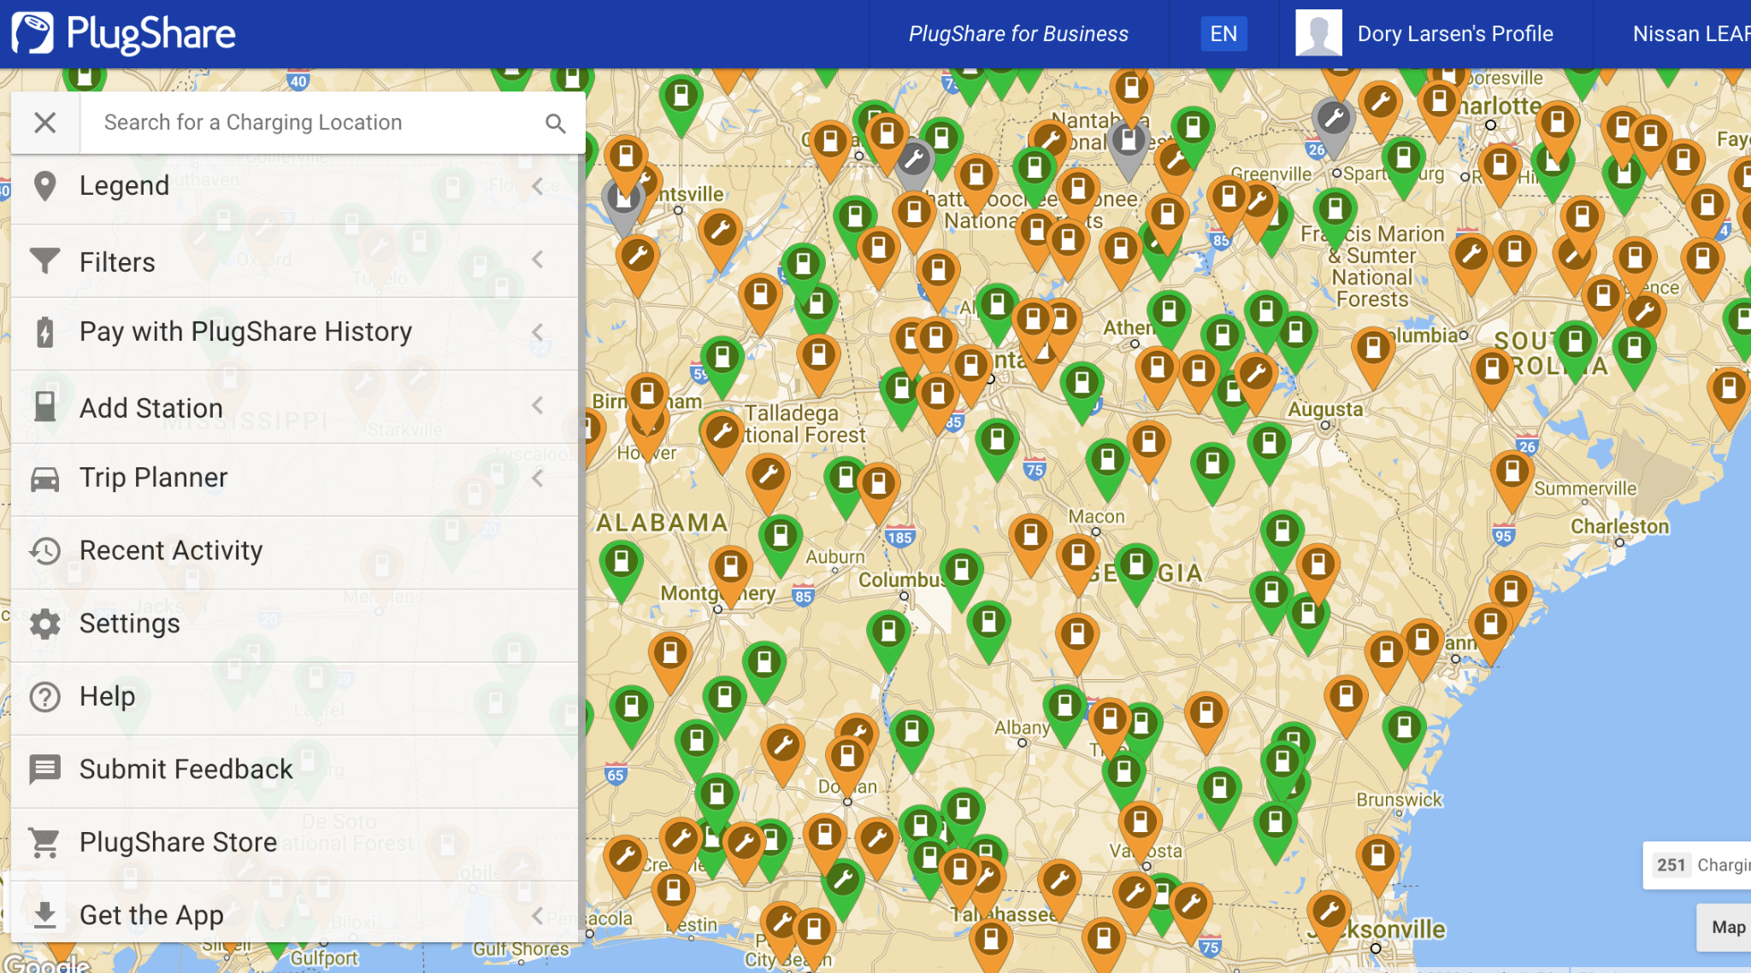
How To Find EV Charging
plugshare.com

Slide 19

IRA Tax Credits and Utility Rebates
Federal EV Tax Credit up to $7,500 for vehicles
Used Clean Vehicle Credit up to $4,000 for vehicles
Alternative Fuel Infrastructure Tax Credit(charging stations)
Utilities have rebates

Slide 20
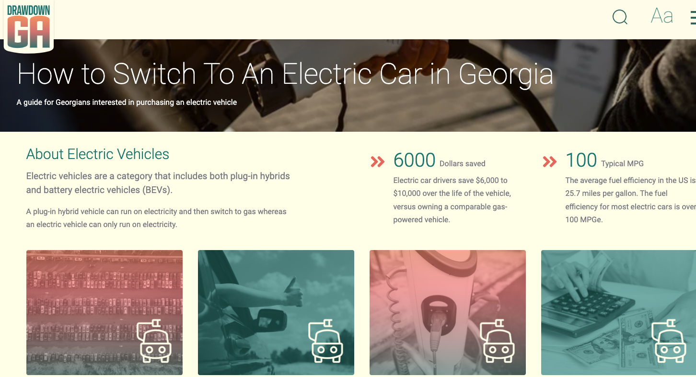
Resources
Drawdown GA EV Toolkit
Plug In America Plugstar Website
EPA Fuel Economy Website
Drive Electric Earth Day
National Drive Electric Week

Slide 21
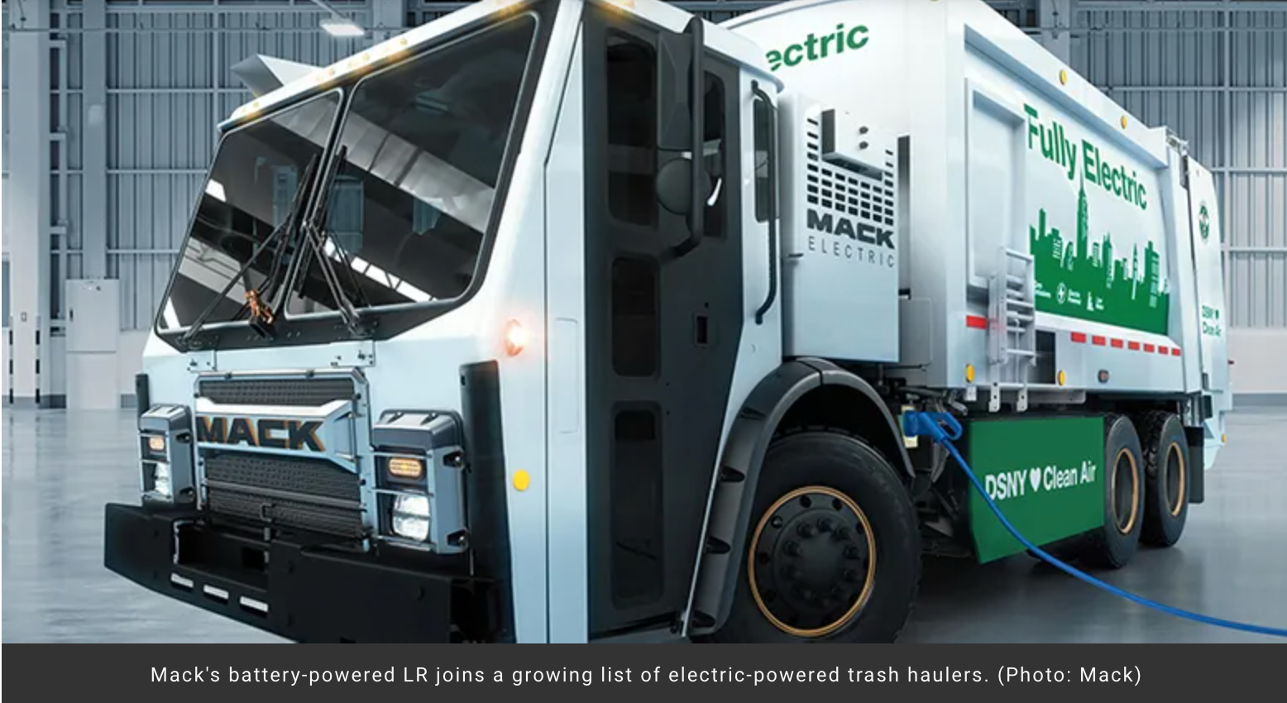

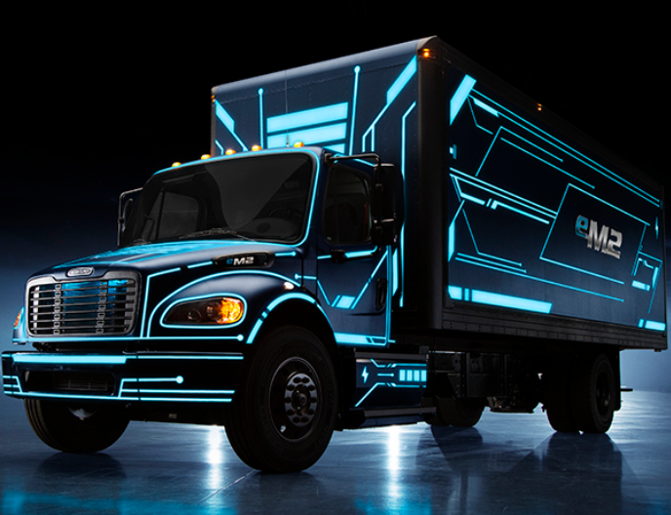
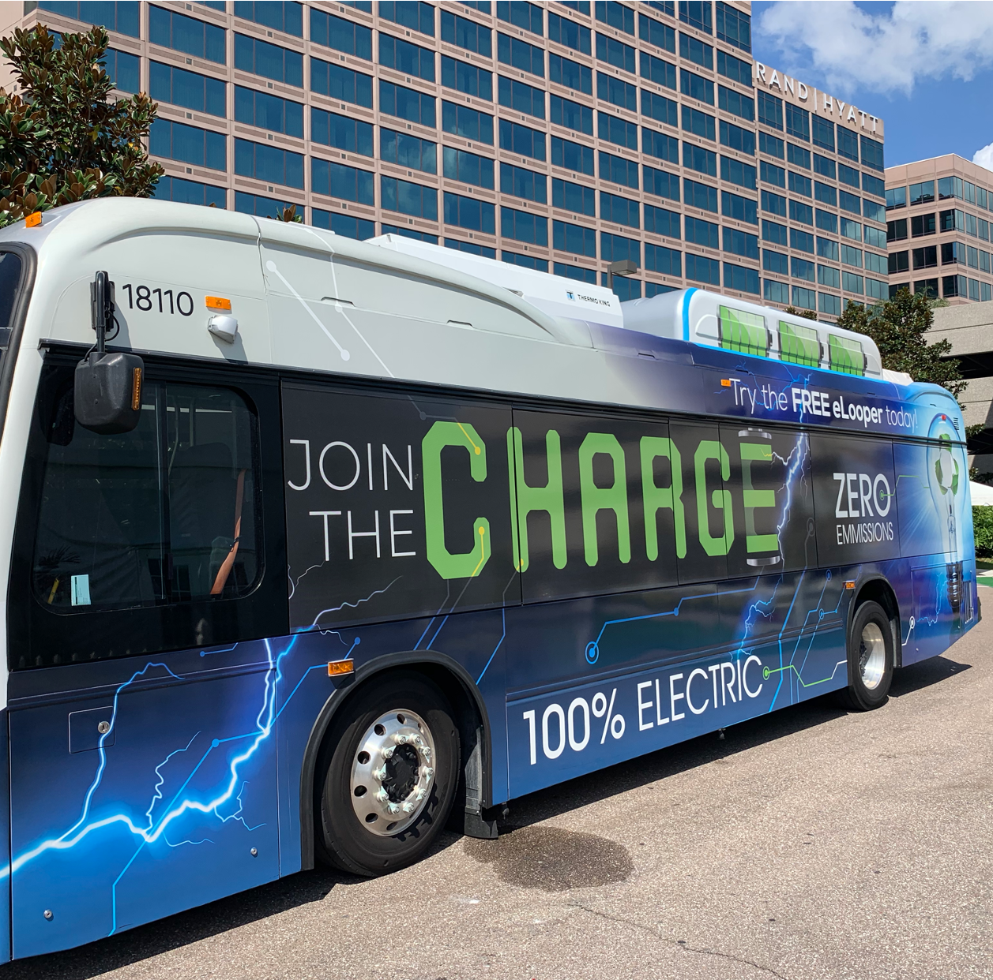
Electric School Buses, Transit Buses and Medium-Duty Trucks
Notes:
Many people don’t realize that there is an electric application for every class of trucks 4-8 and the extent that the automakers are leaning into EV.

Slide 22




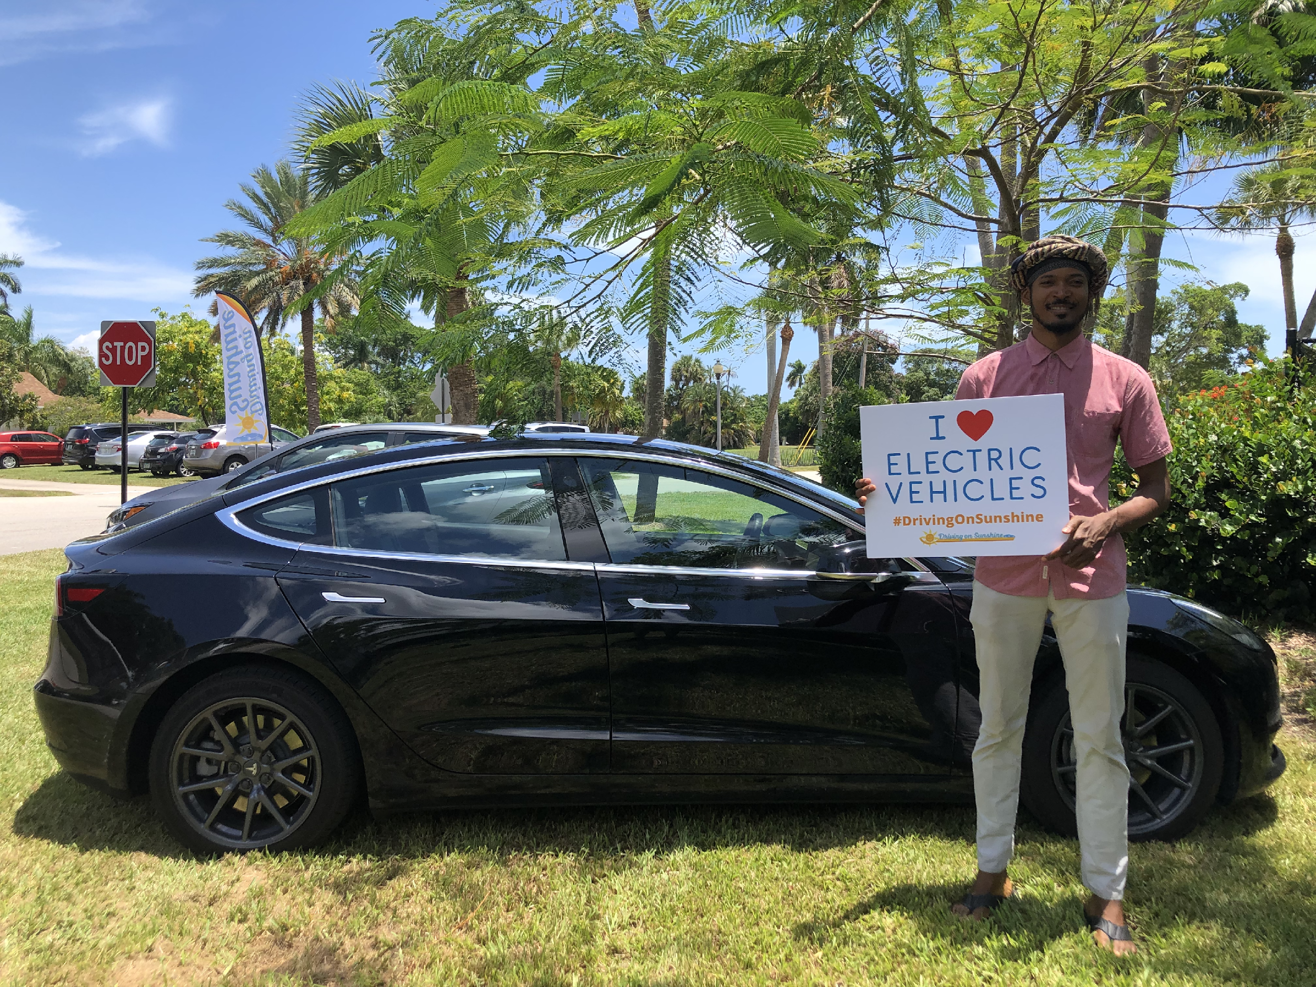

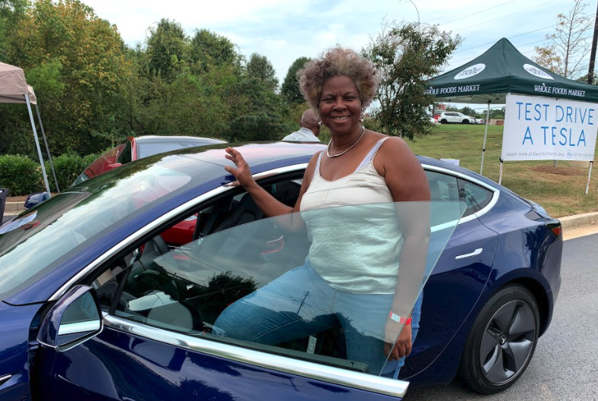
Questions + Stay Connected
ElectrifyTheSouth.org
Monthly newsletters, electric vehicle actions, EV blogs for new and established drivers, and more!
@ElectrifyTheSouth

