Slide 1
Living a Plant-Powered Life
The Personal Health and Planet Health
Benefits of a Plant-Based Diet
Drawdown Georgia
Everyday Climate Solutions:
Tools to Help You Take to Action at Home
April 17th, 2023
Dr. Keisha Callins, MD,MPH
(OB/GYN)
Community Health Care Systems
J0nes/Twiggs County

Slide 2
The Plant-Powered Lifestyle in Action
Who?
  Welcoming you, your family, your friends, your co-workers, and your community
What?
  Getting more of your nutrition from plant sources is a legitimate climate solution
When?
  Choosing plant-based options at breakfast, lunch, dinner, supper, and snacks
Where?
  Using plant-based choices everywhere – home, restaurant, and vacations
Why?
  Reducing your carbon footprint can help to avert the climate crisis

Slide 3
Our Climate Crisis is Connected to Our Food Production
Methane
  Cows, sheep, goats
  Digestion
  Defecation
Nitrous Oxides
  Fertilizers
Carbon Dioxide
  Deforestation
Greenhouse Gas Emissions
Methane
Carbon Footprint
Climate Crisis
Nitrous Oxide
Carbon Dioxide
Notes:
Cutting meat consumption is a powerful and personal thing most Americans can do to tackle the climate crisis, and they can do it immediately. About 40 percent of greenhouse gases come from agriculture, deforestation and other land-use changes. Meat—particularly beef—drives climate change in two ways: first, through cows’ emission of methane, a potent greenhouse gas, and second, by destroying forests as they are converted to grazing land.

Slide 4
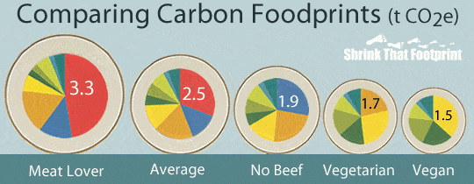
Shrink that FOODprint
Removing beef from the typical American diet, can lower the carbon footprint of our food by almost 25%
Notes:
The American footprint is 16 tons. Globally, the average carbon footprint is 4 tons

Slide 5
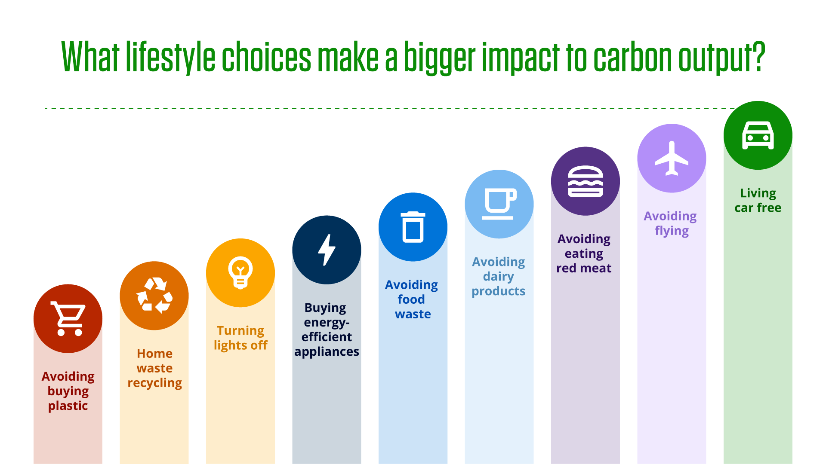
People Power
Little changes can make a big cumulative difference to climate change
Notes:
https://blogs.bath.ac.uk/climate-action/2022/04/13/climate-change-can-one-person-really-make-a-difference/

Slide 6
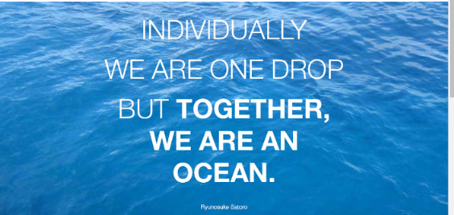
Personal Responsibility vs Corporate Responsibility
Individual acts can grow into influential group activity
One effective act that can easily be amplified, EAT LESS RED MEAT
Consumer demand will influence the industry
Notes:
It is easy to feel helpless in the face of the strength of the fossil-fuel behemoth or to think that calling your congressperson is a meaningless gesture, especially when you learn about the billions of dollars the industry and its allies have spent trying to block Congress from acting. https://www.google.com/url?sa=i&url=https%3A%2F%2Fwww.linkedin.com%2Fpulse%2Findividually-we-one-drop-together-ocean-ryunosuke-satoro-horvat&psig=AOvVaw1uJ-FZML36PpJrI6OGuWEh&ust=1681729512563000&source=images&cd=vfe&ved=0CBIQjhxqFwoTCNCTxeGgrv4CFQAAAAAdAAAAABAp

Slide 7
Let’s Take a Deeper Dive
Switching to a plant-based diet had the potential to offset almost 70% of the heating effect from greenhouse gases emissions and limit global warming by 2 degrees
If you include animal products – reach for pasture-raised options – they can improve land use, nutrient and manure management, and soil health and decrease overall emissions
Notes:
https://journals.plos.org/climate/article?id=10.1371/journal.pclm.0000010

Slide 8
You do not have to become “A Vegan or A Vegetarian” unless you really want to!!!
Notes:
You could become a Pescatarian or a Flexitarian

Slide 9
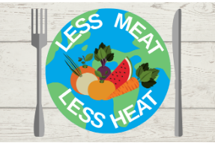
You can become
“A Climatarian”
Notes:
https://www.google.com/url?sa=i&url=https%3A%2F%2Fwww.wpb.org%2Fgovernment%2Fsustainability%2Fget-involved%2Fless-meat-less-heat&psig=AOvVaw2CbZvzbo_heOYir__Stru6&ust=1681729144767000&source=images&cd=vfe&ved=0CBIQjhxqFwoTCICt_bGfrv4CFQAAAAAdAAAAABAE

Slide 10
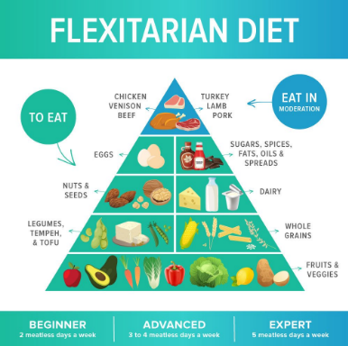
You can become
“A Flexitarian”

Slide 11
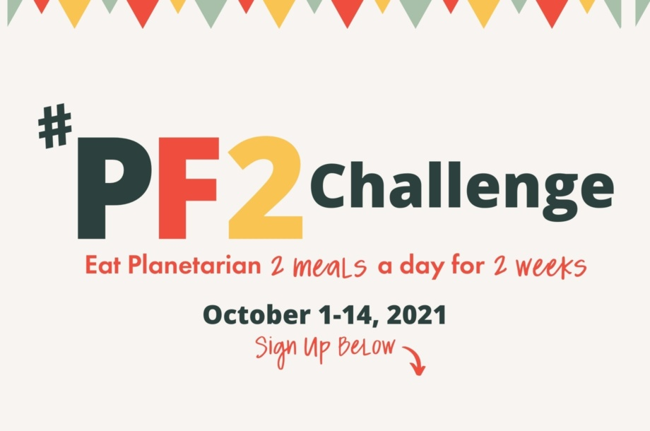
You can become
“A Planetarian”
Notes:
https://www.google.com/url?sa=i&url=https%3A%2F%2Fplanetarianlife.com%2Fblog%2Fjoin-our-pf2-challenge%2F&psig=AOvVaw0Je8krkM7OlulyTVDeckkj&ust=1681729990788000&source=images&cd=vfe&ved=0CAQQjB1qFwoTCOC8wMWirv4CFQAAAAAdAAAAABAE

Slide 12


Can you still get protein from a plant-based diet?
You can still get adequate protein and build muscle on a plant-based diet.
Did you know that spinach is packed with protein?
Notes:
What is a ballerina’s favorite veggie? Spin-Ach : https://tippytoegirl.com/2020/12/importance-of-nutrition-for-dancers-what-i-eat-in-a-day-as-a-professional-ballet-dancer/

Slide 13
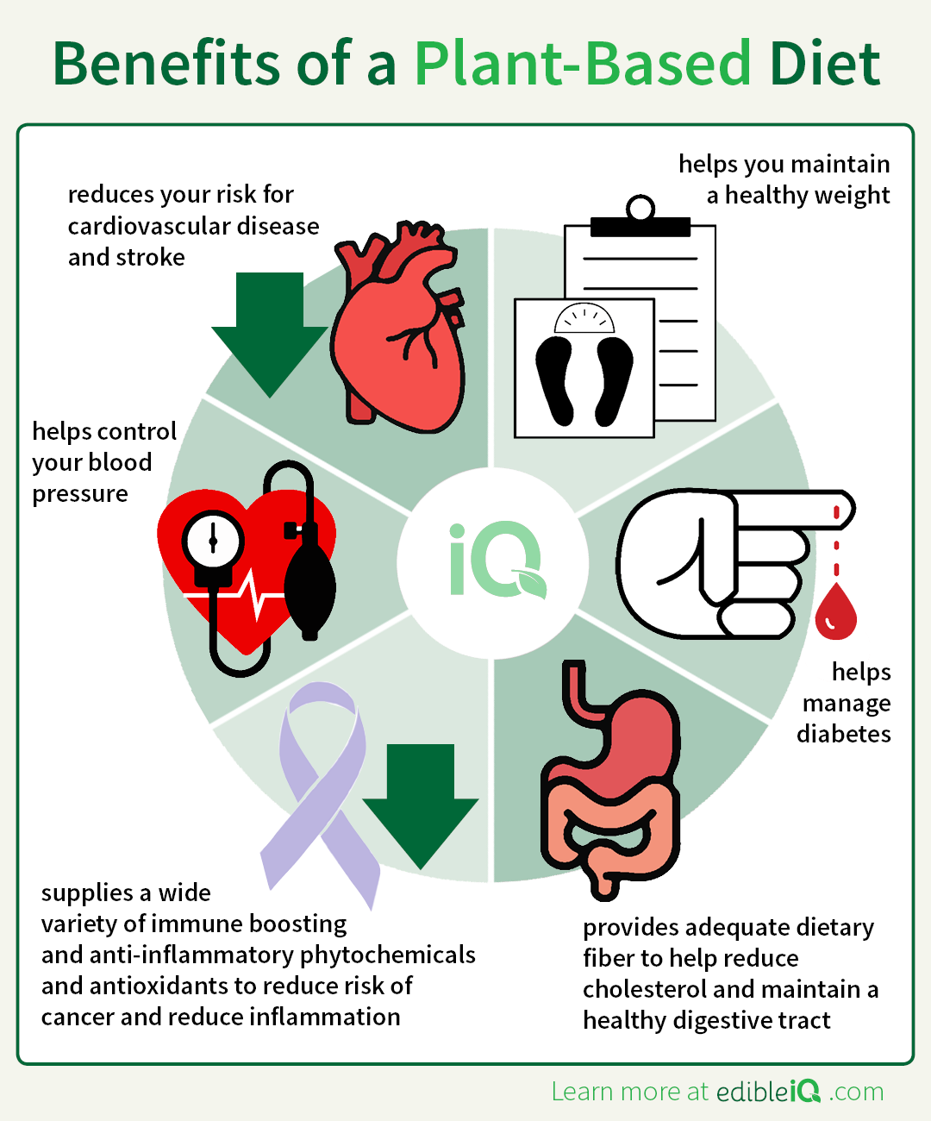
How can a plant-based diet impact your health?
You can reduce the risk of heart disease, diabetes, and high blood pressure.
Did you know that a plant-based diet can help boost your immune system?
Notes:
https://edibleiq.com/articles/benefits-of-a-plant-based-diet/

Slide 14
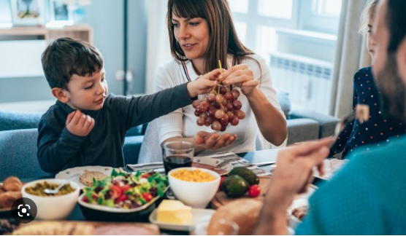
Will it cost more to eat more plant-based diet?
Buy Local
Eat from the “Rainbow”
Buy in Season
Choose Fresh or Frozen
Buy in Bulk
Notes:
https://www.google.com/url?sa=i&url=https%3A%2F%2Fwww.savvymom.ca%2Farticle%2Fhow-to-become-a-vegetarian-family%2F&psig=AOvVaw3iixZcfO_o689WBGitACCz&ust=1681698450874000&source=images&cd=vfe&ved=0CBIQjhxqFwoTCJCJ3puxrf4CFQAAAAAdAAAAABAE

Slide 15
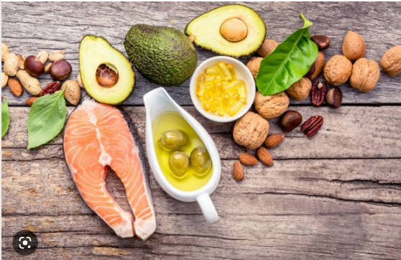
Will I need extra supplements if I eat less meat?
A combination of vegetables, beans, peas, nuts, seeds, whole grains, and tofu as well as occasional dairy, eggs, poultry , and fish will provide essential nutrients.
Did you know that salmon is a source of Vitamin B-12?
Notes:
https://www.google.com/url?sa=i&url=https%3A%2F%2Fwww.cambridge-news.co.uk%2Fnews%2Fhealth%2Fvitamin-b12-deficiency-how-much-23460870&psig=AOvVaw2C-Ij85oZNPVdzwVR1ZecG&ust=1681699791657000&source=images&cd=vfe&ved=0CBIQjhxqFwoTCIiRsYayrf4CFQAAAAAdAAAAABAE

Slide 16
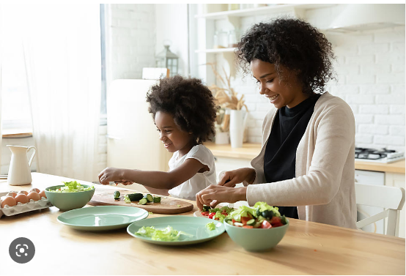
Will I get bored with a plant-based diet?
Channel your Creative Energy
Collaborate with Family and Friends
Mix and Match Meal Prep
Notes:
https://thebeet.com/plant-based-family/

Slide 17
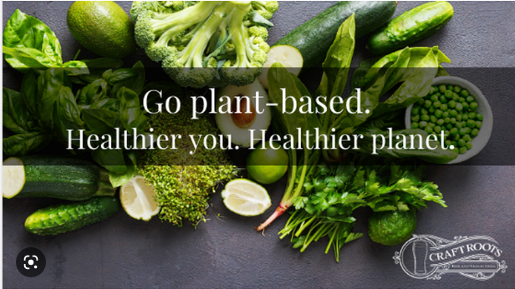
Let me show you the way…
Eating In…
Eating Out…
  Breakfast:
    Veggie omelet
  Lunch:
    Pizza with veggie toppings
  Dinner:
    Pad Thai with Tofu
  Breakfast
    Oatmeal with dried fruit
  Lunch
    Black bean burger
  Dinner
    Chicken lettuce wraps
Notes:
https://www.google.com/url?sa=i&url=https%3A%2F%2Fwww.craftroots-mh.com%2Fblog%2Fgoing-100-plant-based-for-a-healthier-you-and-a-healthier-planet&psig=AOvVaw1_tFDt41KF0gEvPqiRP9yn&ust=1681727063710000&source=images&cd=vfe&ved=0CBIQjhxqFwoTCOj799GXrv4CFQAAAAAdAAAAABAZ

Slide 18
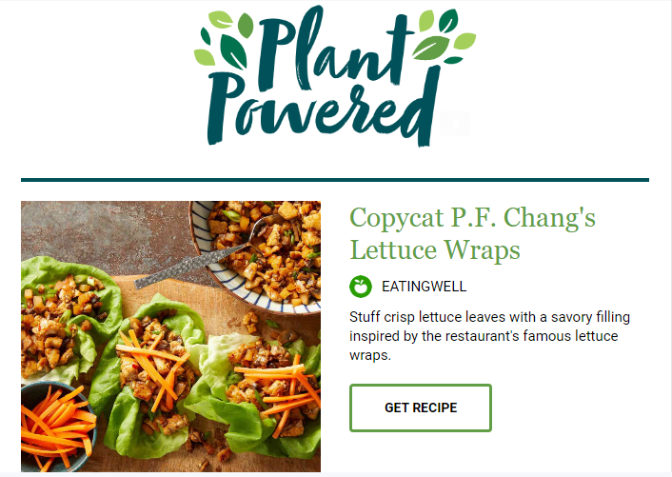

Notes:
Eating Well Magazine - https://www.eatingwell.com/

Slide 19
Your Elevator Pitch
“ Want to know what you can do to help with climate change?
Well, cutting back on red meat is good for the planet and good for your health.
So, while I won’t ask you to stop eating burgers…
I will ask you to eat burgers less often and when you do, eat pasture-fed burgers…
You are in control and can start right away… no delay!”
Notes:
https://cleanchoiceenergy.com/news/plant-based-eating-can-help-our-planet#:~:text=A%20person%20who%20eats%20a,of%20CO2%20equivalent%20every%20day!

Slide 20
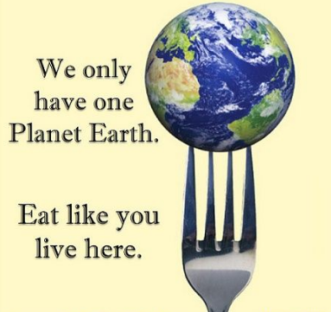
So, What’s Your Why?
Plant-based eating can preserve the ecosystem and environment
Plant-based eating can support a healthy lifestyle for you and your family, friends, and community
Plant-based eating can make a difference for future generations
Notes:
https://www.google.com/url?sa=i&url=https%3A%2F%2Fwww.pinterest.com%2Fpin%2Ffor-earth-day-heres-how-to-save-the-planet--531565562250570900%2F&psig=AOvVaw1_tFDt41KF0gEvPqiRP9yn&ust=1681727063710000&source=images&cd=vfe&ved=0CBIQjhxqFwoTCOj799GXrv4CFQAAAAAdAAAAABAp

